Slide 1

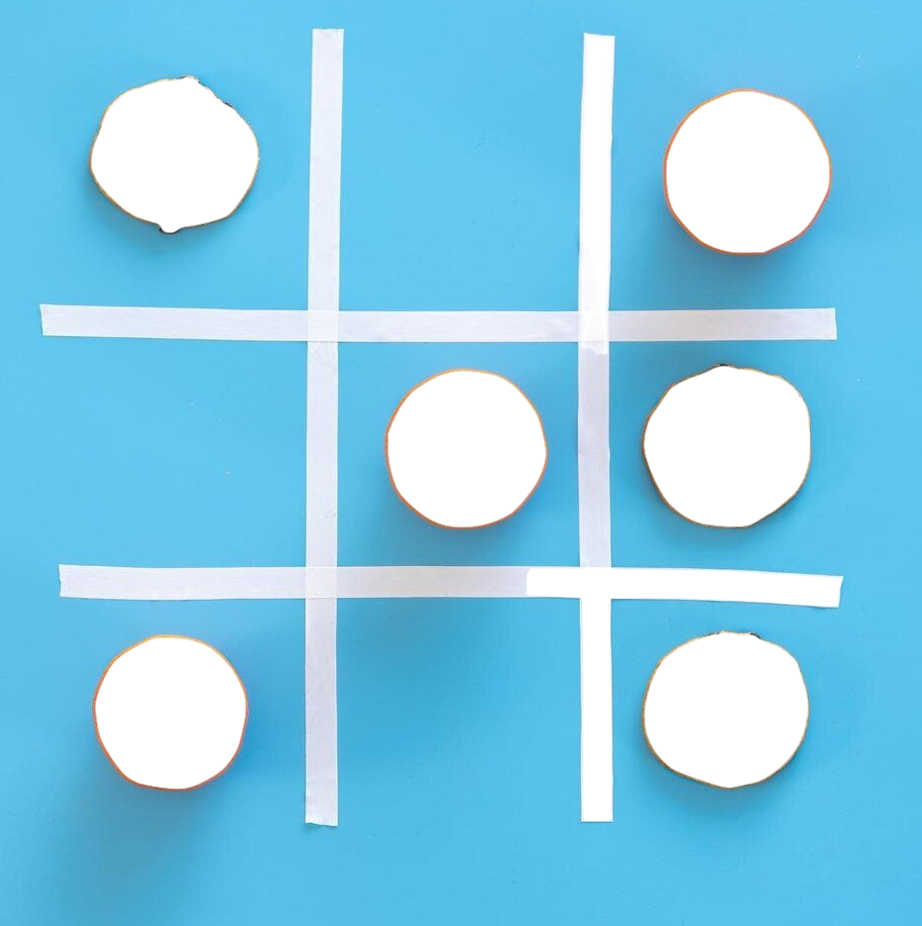
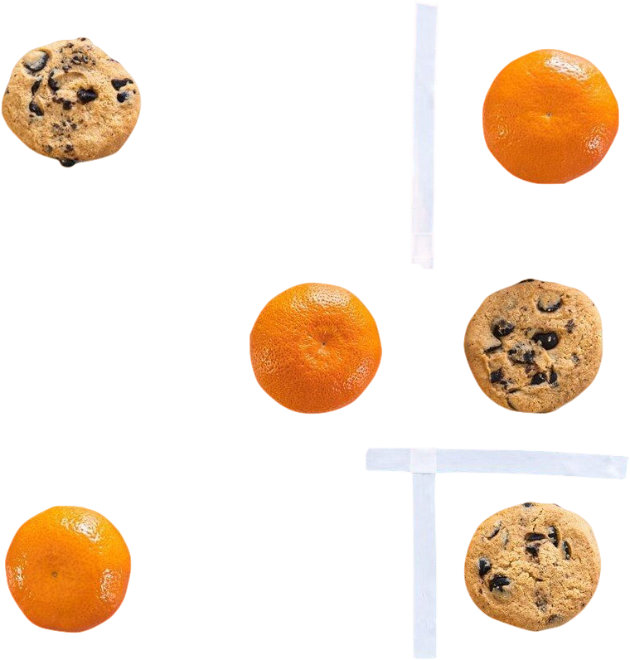
United Institute of Technology
A mini project on TIC~TAC~TOE
By- AMAN AMOL ADITYA ABHISHEK
Under the Guidance of GAURAV SIR

Slide 2

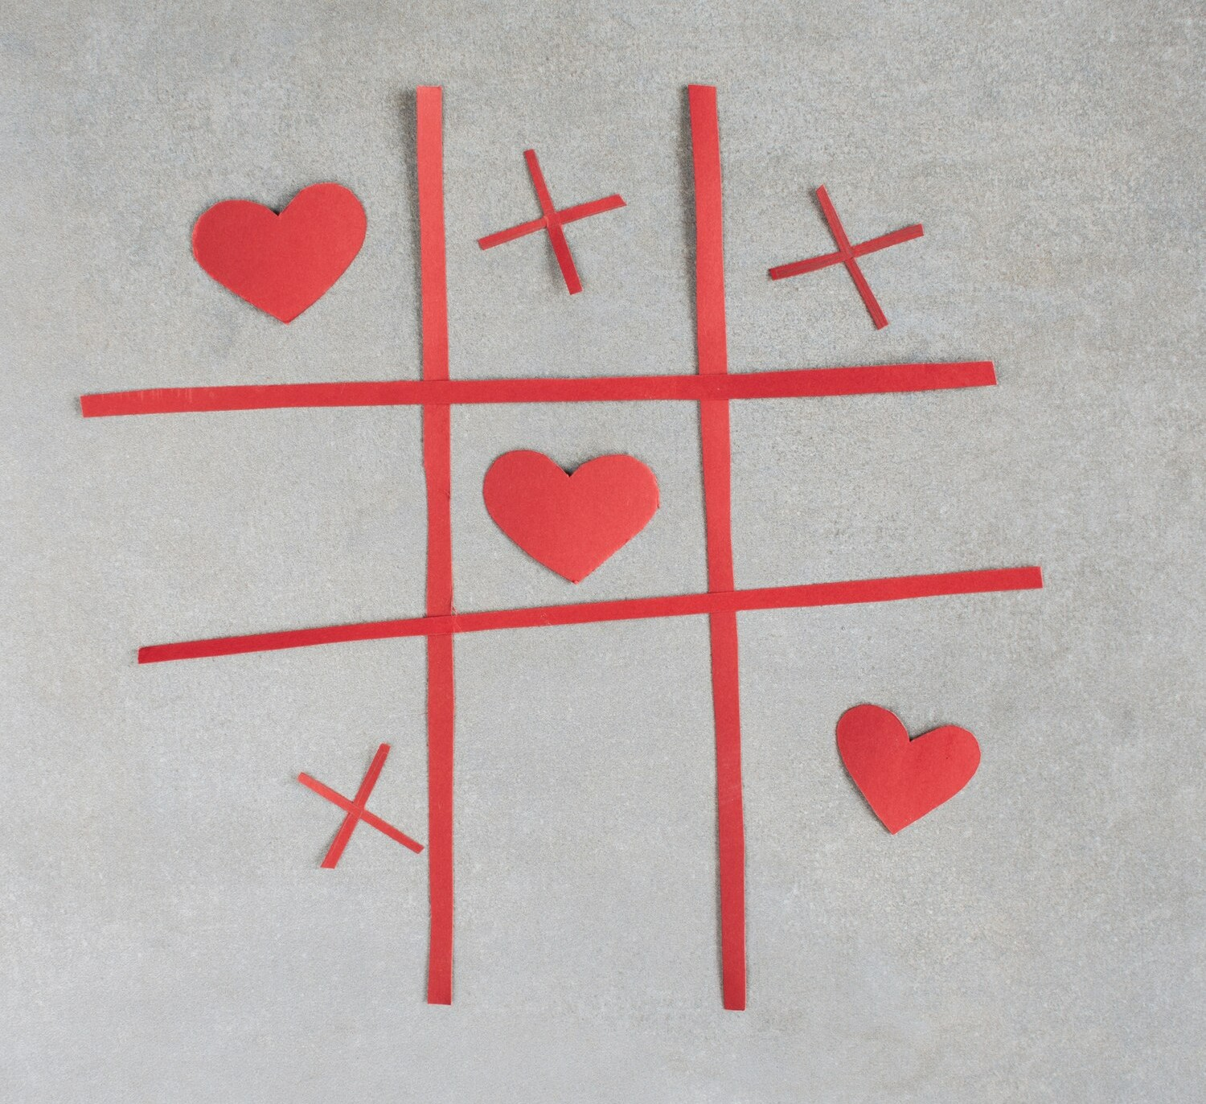
Introduction to Tic Tac Toe
Tic Tac Toe is a classic game that challenges players to think strategically. In this presentation, we will explore the fundamentals of the game, key strategies, and how to improve your gameplay.
Understanding the basics will set the foundation for mastering this seemingly simple yet complex game.

Slide 3

Existing Systems: A look at the past
Traditional Board Games Early digital implementations
Traditional Tic Tac Toe game have been played for centuries often using a simple grid drawn on paper on carved on a boad
The early digital version of tic tac toe appeared at personal computers and hand held console in the late 20th centure
Mobile Apps Era
The rise of smartphones and tablets has brought about a surge in mobile Tic Tac Toe applications making the game readily accessible .

Slide 4

Object Oriented Design
Proposed System: Java implementations
The Java implementation utilizes object- oriented programming principles to represent the game board, player, and end game logic.
Graphical user interface(GUI)
A user-friendly GUI is developed using a java GUI library, providing an interactive and visually appealing experience.

Slide 5


Game Rules Overview
The rules of Tic Tac Toe are straightforward: two players take turns marking a square on a 3x3 grid. The ﬁrst to align three marks in a row, column, or diagonal wins. Understanding these rules is crucial to developing effective strategies and anticipating your opponent's moves.

Slide 6

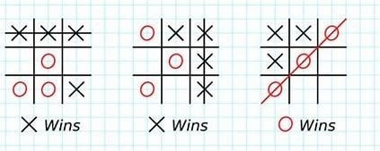
Basic Strategies
To increase your chances of winning, employ basic strategies such as starting in the center, blocking your opponent's moves, and creating multiple winning opportunities. These tactics can help you gain the upper hand and lead to more frequent victories in your games.

Slide 7
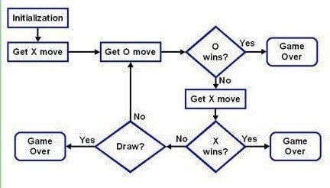
Flow chat

Slide 8
Future scope
Tic Tac Toe is a simple game that can be implemented in many ways. Here are some features
you could consider:-
1. Single-player mode.
Multi-player mode.
Multi-player Online 4. Difﬁculty level
customizable game board.
Undo move
7. RestartGame

Slide 9




Thanks!
Do you have any questions?

